Slide 1
Remote Debugger
Continuous Integration
Hanna Boguslawska
November 21, 2017
Public

Slide 2
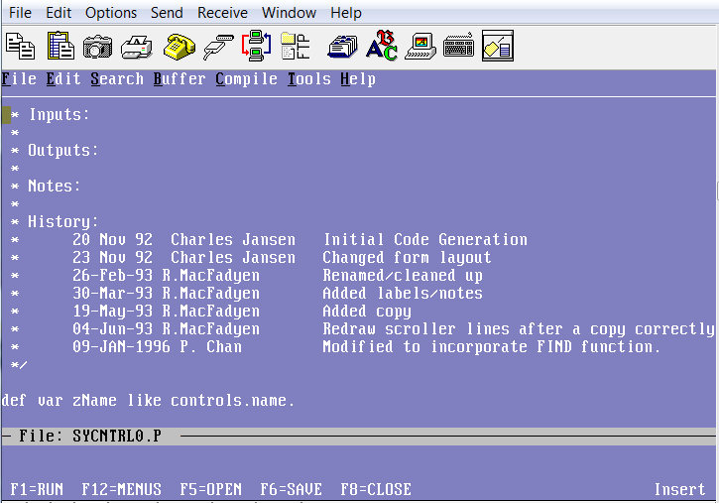
Remote Debugger – a bit of History
Public

Slide 3
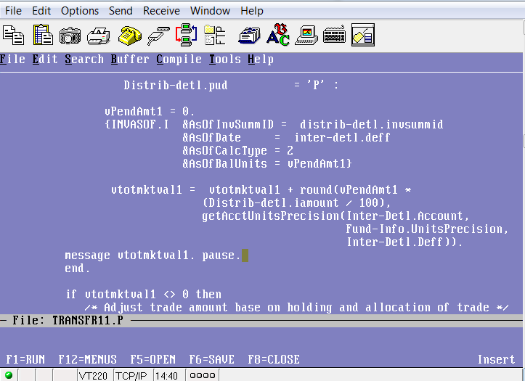
Remote Debugger - Debugging Strategy
Public

Slide 4
Remote Debugger - PDSOE
IFAST application is designed for UNIX
PDSOE is Windows development tool
Remote Debugger – the perfect solution
Public

Slide 5
Remote Debugger - initial setup problems
3 Progress Hot Fixes were required to get Remote Debugger working
PSC00350877 PDSOE debugger doesn't stop at breakpoint 11.7.0 Hot Fix 11.5.1.035 – Linux
PSC00354900 PDSOE remote (detached) debugger can't show source for files whose extension is upper case P (.P) 11.7.1.0 Hot Fix 11.5.1.043 - Windows
PSC00306174 PDSOE Debugger Watch Expressions view slows down debugger performance 11.7.2.0 Hot Fix 11.5.1.047 – Windows
All fixes should be available in 11.7 Service Pack.2.0", (11.7.2.0)
Public

Slide 6
Remote Debugger - Configuration
Programs have to be accessible on both systems
Programs must be compiled
The debugger must be enabled on both Windows and Linux
This is done just once per system
Progress Session must be started with debugReady port
mpro Sports –debugReady 9999
Public

Slide 7
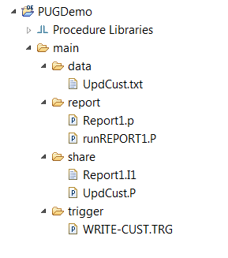
Remote Debugger - PDSOE Configuration
Directory Structure
Public

Slide 8
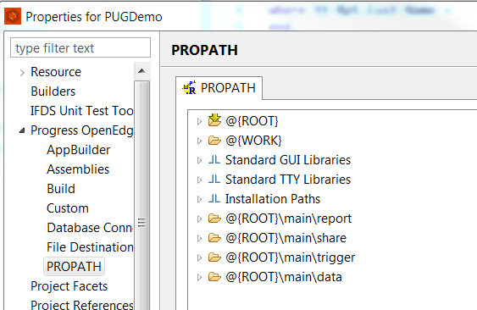
Remote Debugger - PDSOE Configuration
PROPATH
Public

Slide 9
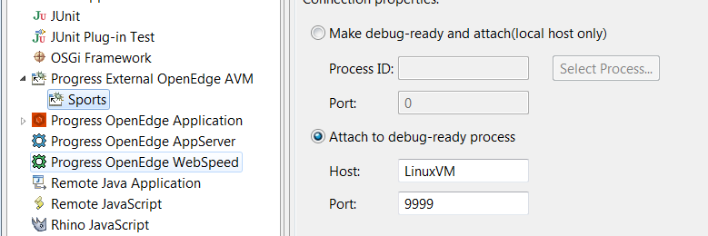
Remote Debugger - PDSOE Configuration
Remote Debugger Host and Port
Public

Slide 10
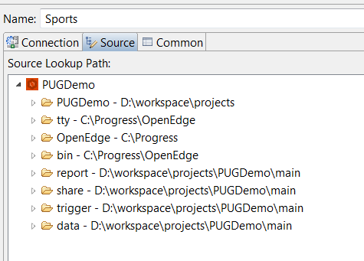
Remote Debugger - PDSOE Configuration
Remote Debugger Source Code
Public

Slide 11
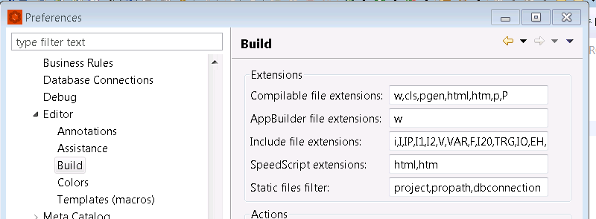
Remote Debugger - Adding File extensions
File extensions used by debugger must be configured within PDSOE
Public

Slide 12
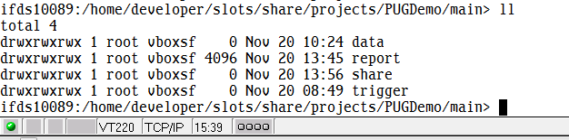
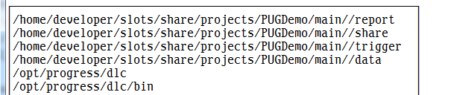
Remote Debugger - Linux Configuration
Linux Directory Structure:
Linux Propath:
Public

Slide 13
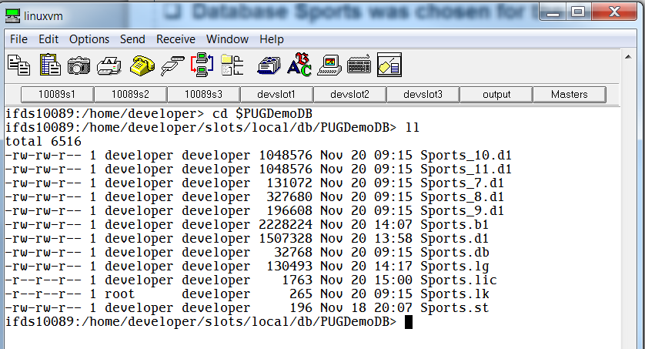
Remote Debugger - Demo
Database sports was chosen for the demo, was named Sports:
Public

Slide 14
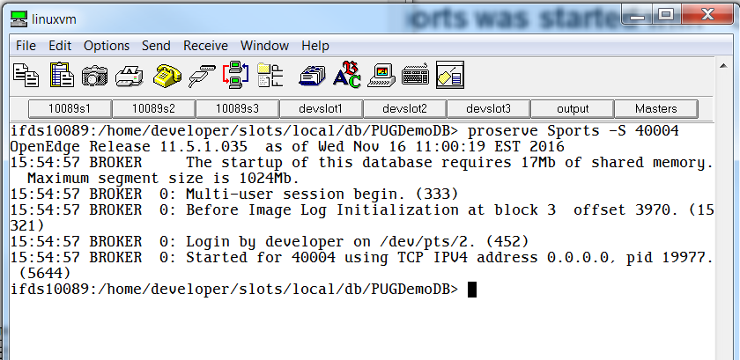
Remote Debugger - Demo
Server for Sports was started with –S 40004
Public

Slide 15
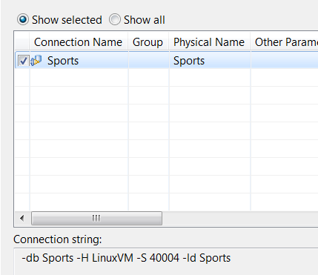
Remote Debugger - Demo
Connection from PDSOE project
Public

Slide 16
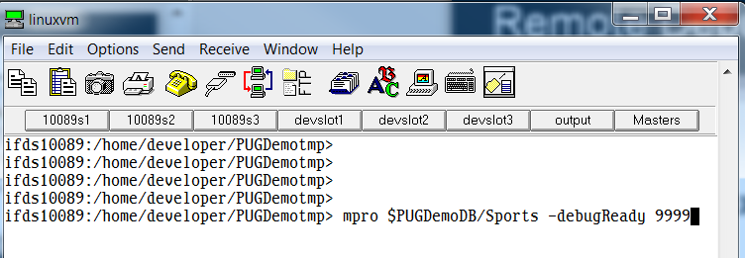
Remote Debugger - Demo
Starting Progress Linux Session for Remote Debugger
Public

Slide 17
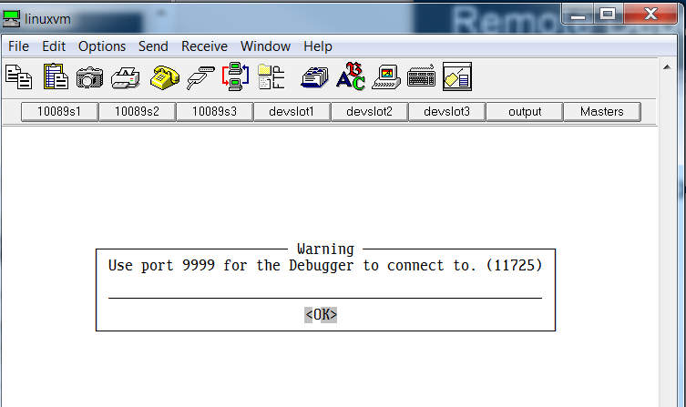
Remote Debugger - Demo
Linux Progress Session Ready for debugging
Public

Slide 18
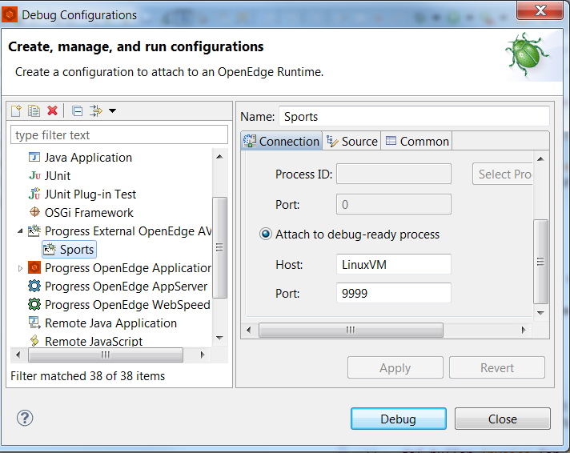
Remote Debugger - Demo
Starting Remote Debugger session on PDSOE
Public

Slide 19
Remote Debugger - Demo
The code used during the debugging session Report1.p consists of the main and internal procedure and external procedure. It also includes one module.
During the session the trigger is invoked.
Debugger features covered during the demo
Step Into, Step Over, Step Return, Resume
Breakpoints
Watchpoints
Values of variables, database and temp-table fields.
Changing variable values during debugging
Public

Slide 20
Remote Debugger - Demo
The code used during the debugging session Report1.p consists of the main and internal procedure and external procedure. It also includes one module.
During the session the trigger is invoked.
Debugger features covered during the demo
Step Into, Step Over, Step Return, Resume
Breakpoints
Watchpoints
Values of variables, database and temp-table fields.
Changing variable values during debugging
Public

Slide 21
Remote Debugger - Helpful links
https://documentation.progress.com/output/ua/OpenEdge_latest/index.html#page/pdsoe/attachable-debugger.html
https://documentation.progress.com/output/ua/OpenEdge_latest/index.html#page/dpspr/enable-attachable-debugging-(-debugready).html
https://documentation.progress.com/output/ua/OpenEdge_latest/index.html#page/pdsoe%2Fprerequisites-for-using-the-debugger.html%23wwID0EO5OX
https://documentation.progress.com/output/ua/OpenEdge_latest/pdsoe/PLUGINS_ROOT/com.openedge.pdt.debugger.help/rfi1350488953966.html#rfi1350488953966
Public

Slide 22

Questions
Public

